Slide 1
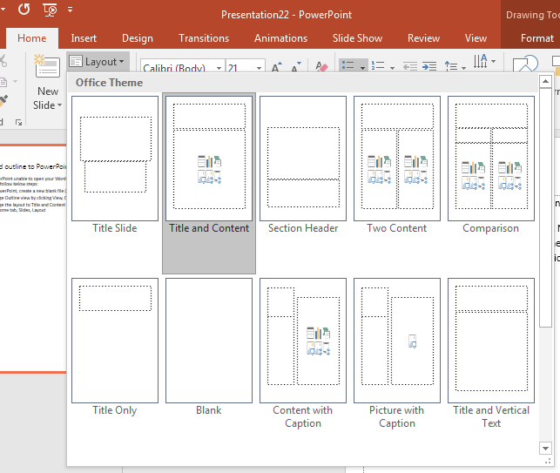
Word outline to PowerPoint
If PowerPoint unable to open your Word outline please follow below steps:
In PowerPoint, create a new blank file (CTRL N)
Change Outline view by clicking View, Outline view
Change the layout to Title and Content by clicking the Home tab, Slides, Layout
Go to Word copy the contents, then paste it to PowerPoint Outline view pane

Slide 2
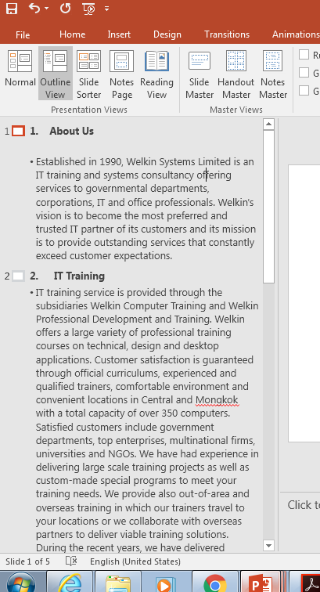
Press enter
Press tab
Press Shift tab

